Slide 1
Math Analysis Final
By: Austin Boyer

Slide 2
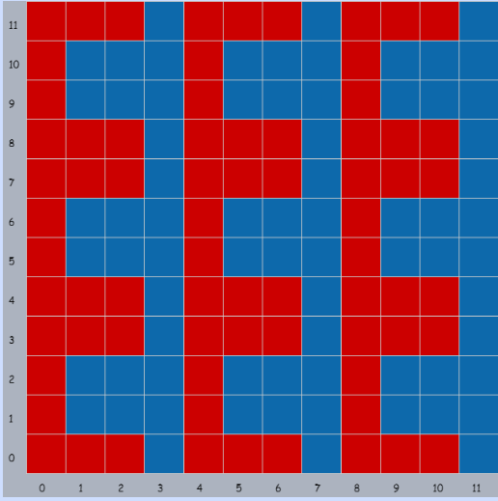
01_Patterns
This is the first project we did in bricklayer.
We used the grid at first so there is no code it was a point and click to make the pattern.

Slide 3
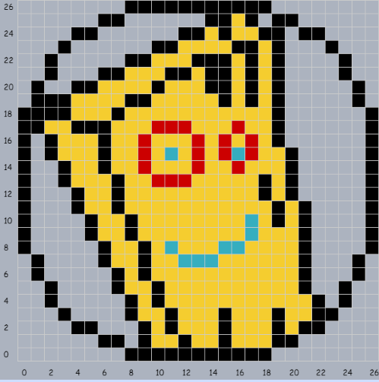
02_Pixel Art
We moved past making a simple pattern in this one.
For this project you would find something made into to pixel art and we would copy it in the gird on bricklayer.
I chose to do plank from ed edd n eddy.

Slide 4
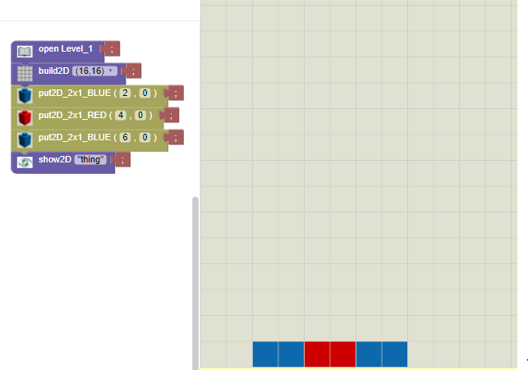
03_Saving in bricklayer
This was the first project we did in bricklayer lite.
We made just a simple line of code in lite.

Slide 5
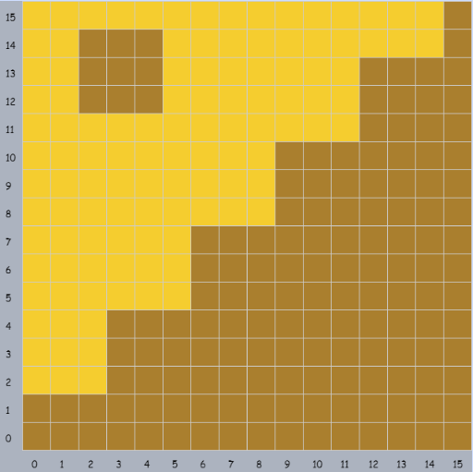
05_Objects Around Bryan
This was the first project that we took a real life image and made it in code.
I used the grid because coding it in bricklayer 1 would take to long to make.
My image was a picture of the library floor.

Slide 6
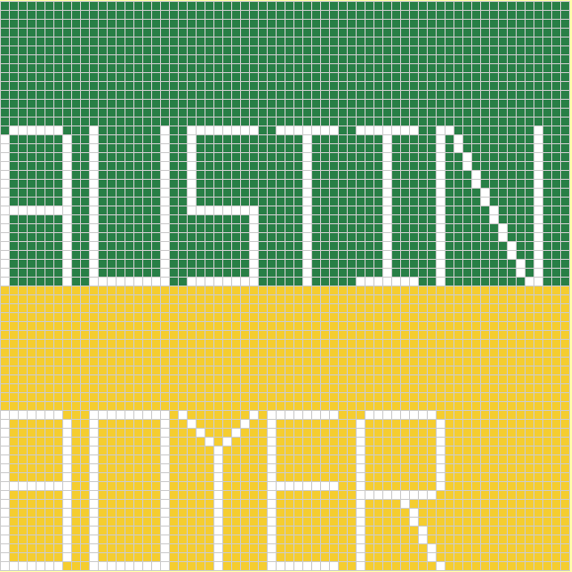
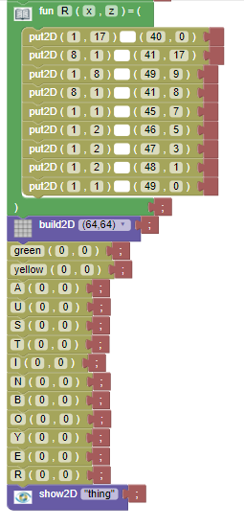
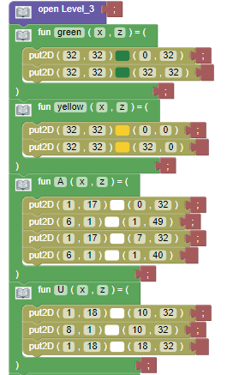
06_Name Project
This Project took me a while to finish.
I went through all of the bricklayer levels.
I finished it using level 3.

Slide 7
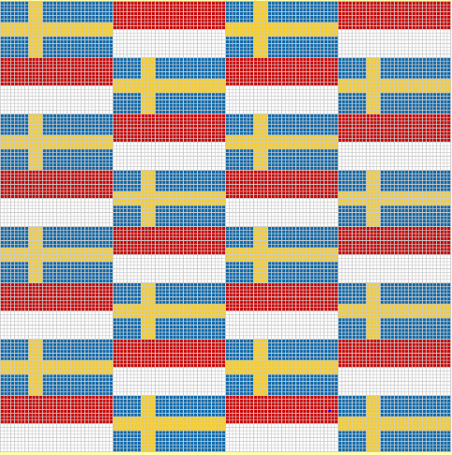
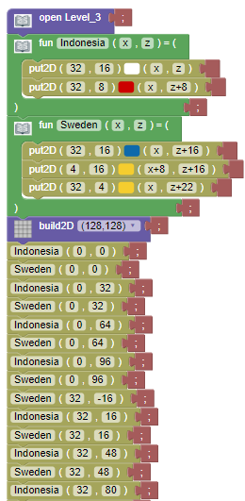
07_Flag Pattern
On this project we took two flags and used the offsets to make a pattern with them.
I used the Indonesia flag and Swedish flag.

Slide 8
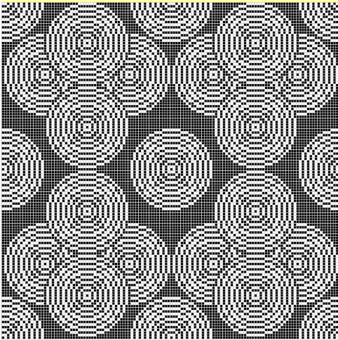
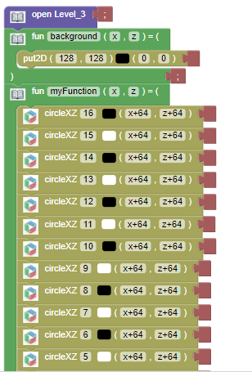
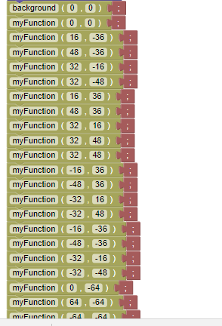
10_Circle Pattern
In the circle pattern it was the first time using the circle code and messing with the radius of things.
I took my first code and offset it in different places to make the pattern.

Slide 9
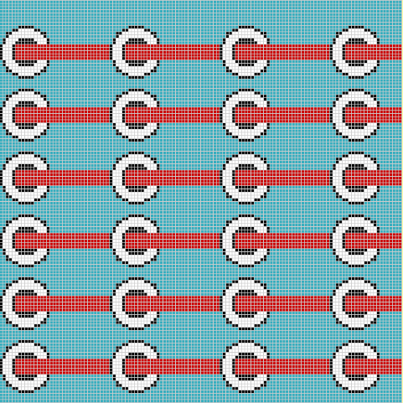
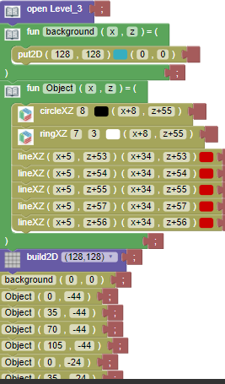
11_All Functions
In this project we used all the functions in one project.
And then we sent it to a friend to finish it with the code.

Slide 10
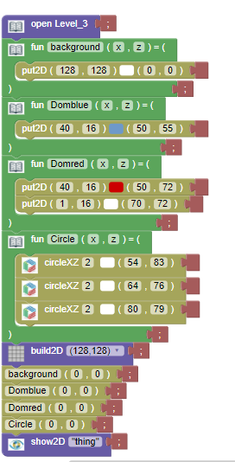
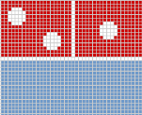
12_Real Image
In this project we made a code to make a real life logo.
I used the dominos logo because it was simple and nice looking.

Slide 11
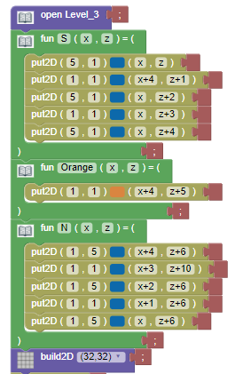
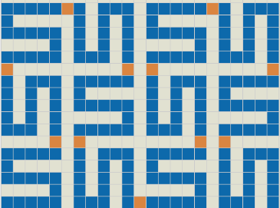
13_Curves
This was our last project we have done.
It was curves that were all connected from the start.

